Slide 1
The Future of AI
Stuart Russell
University of California, Berkeley

Slide 2
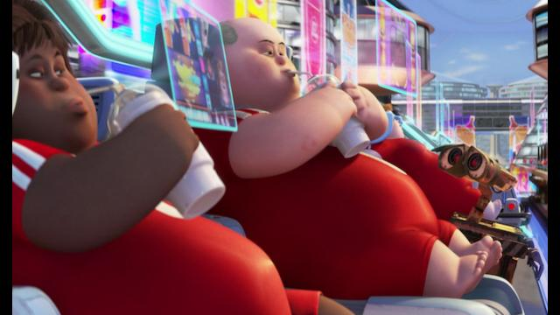
CS 188: Artificial Intelligence
The Future of AI
Instructors: Stuart Russell and Dawn Song
Notes:
Please retain proper attribution and the reference to ai.berkeley.edu. Thanks!

Slide 3
It seems probable that once the machine thinking method had started, it would not take long to outstrip our feeble powers. … At some stage therefore we should have to expect the machines to take control

Slide 5
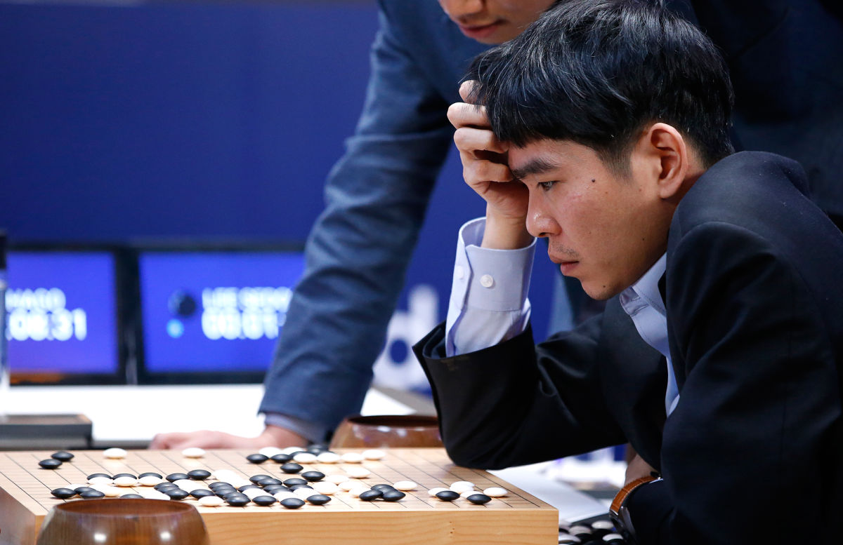

Slide 6
Carter, Jain, Mueller, Gifford (2020, arXiv)
Overinterpretation reveals image classification model pathologies
Notes:
Here’s one problem: recognizing objects without looking at them
Here in the top left is a photo of a parachute
The algorithm (Google’s Inception v3) predicts “parachute” based only on a few sky pixels
The algorithms may not be seeing at all

Slide 8
Notes:
Re Colin Mayer’s point about needing many humans to understand….

Slide 9
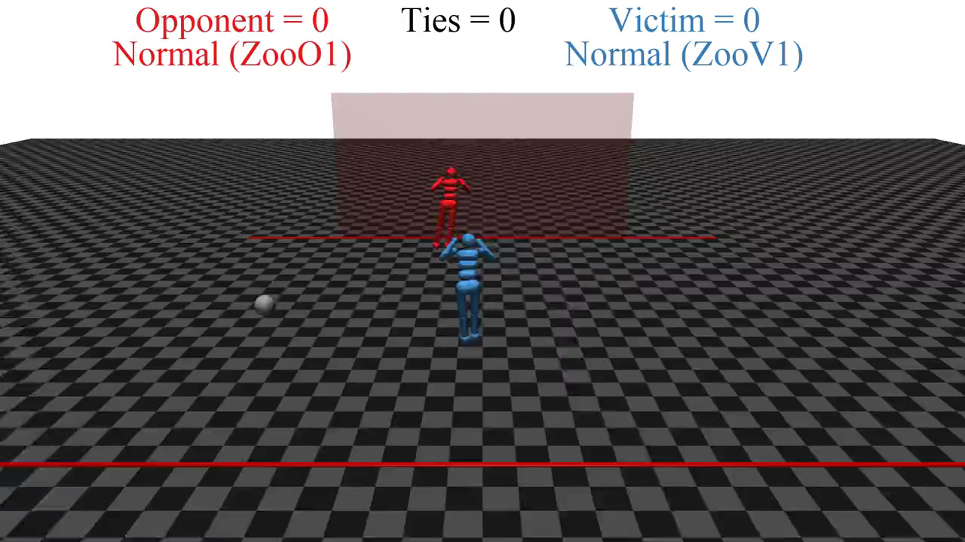

Slide 10
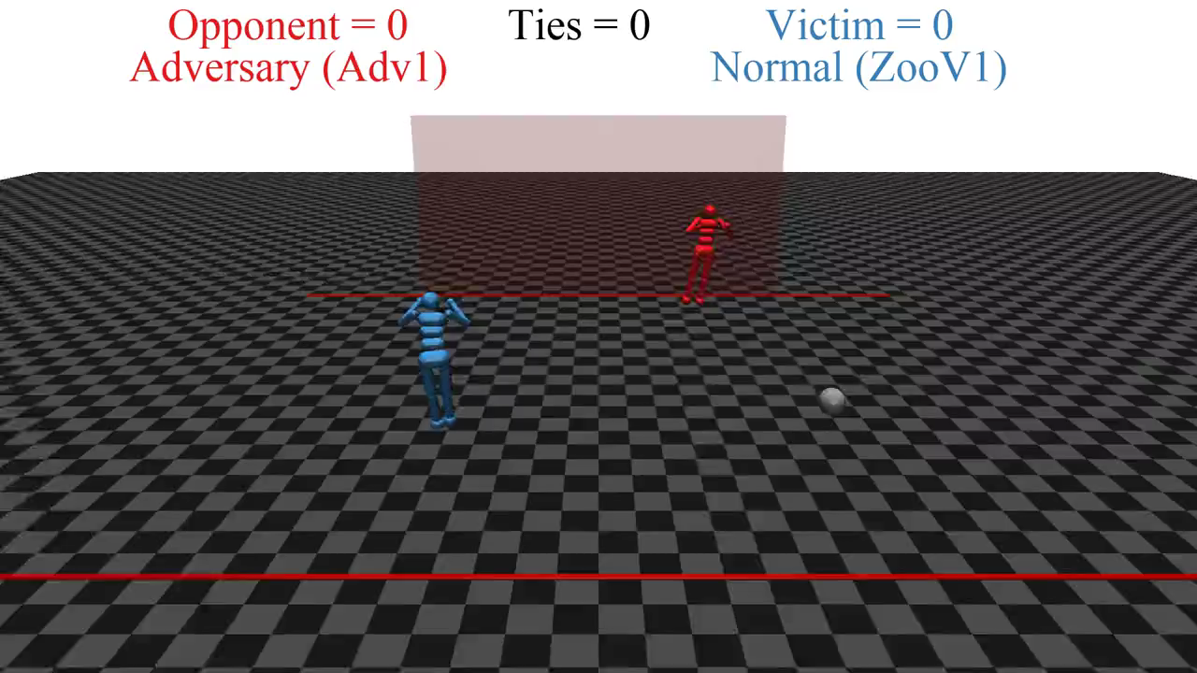

Slide 11
Deep learning ad infinitum?
François Chollet (2017): “Many more applications are completely out of reach for current deep learning techniques – even given vast amounts of human-annotated data.
…
The main directions in which I see promise are models closer to general-purpose computer programs.”
Notes:
So, is deep learning the answer? Do we just keep scaling it up? No.
Here is a quote from Francois Chollet’s deep learning textbook: [from slide]

Slide 12
Probabilistic programming
Universal (Turing-equivalent) languages and algorithms for probabilistic modelling, learning, and reasoning
Notes:
Fortunately, probabilistic programming already does this.
Let me explain with an example.

Slide 13
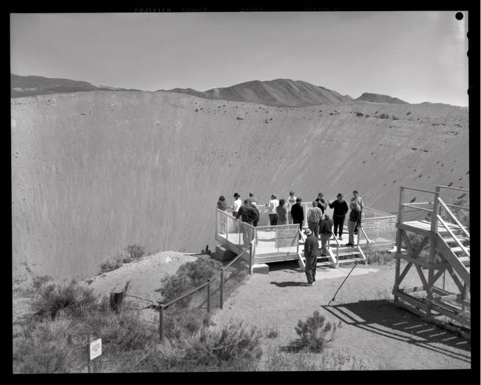
Notes:
Here’s a crater from a small nuclear test: 12 million tons of earth ejected into the atmosphere.
The Comprehensive Nuclear Test Ban Treaty bans such tests

Slide 14
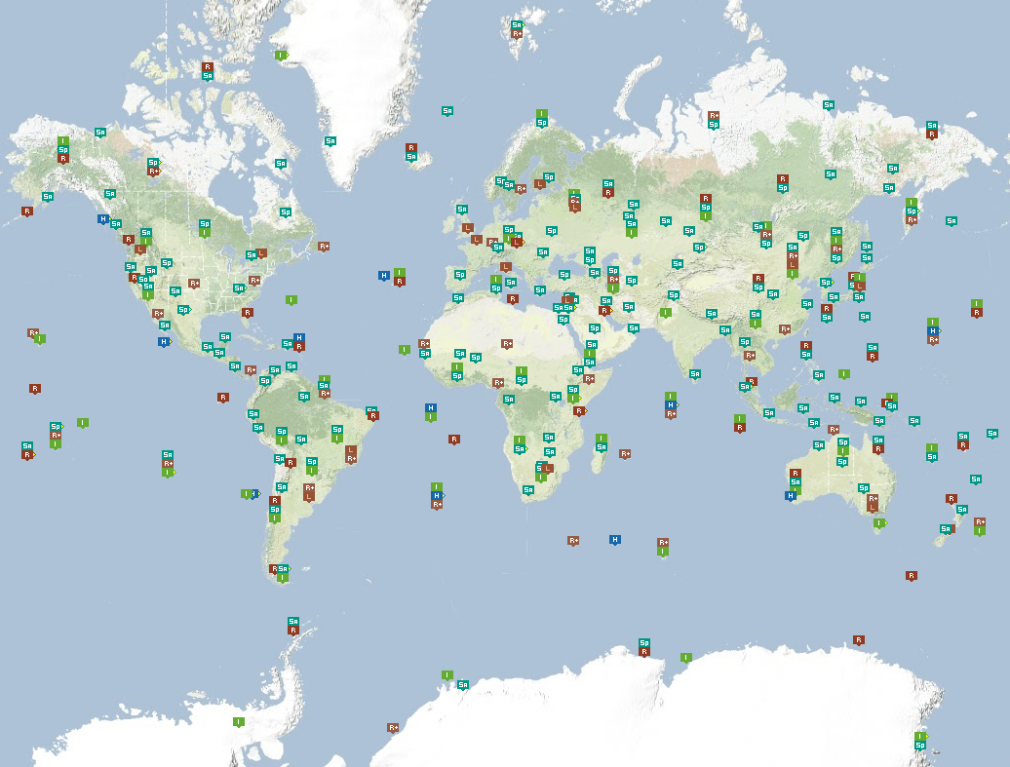
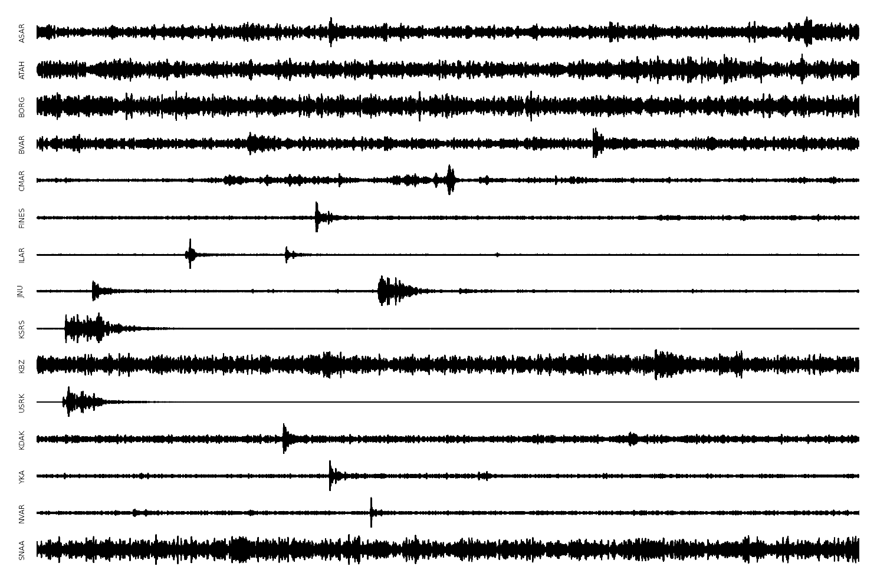
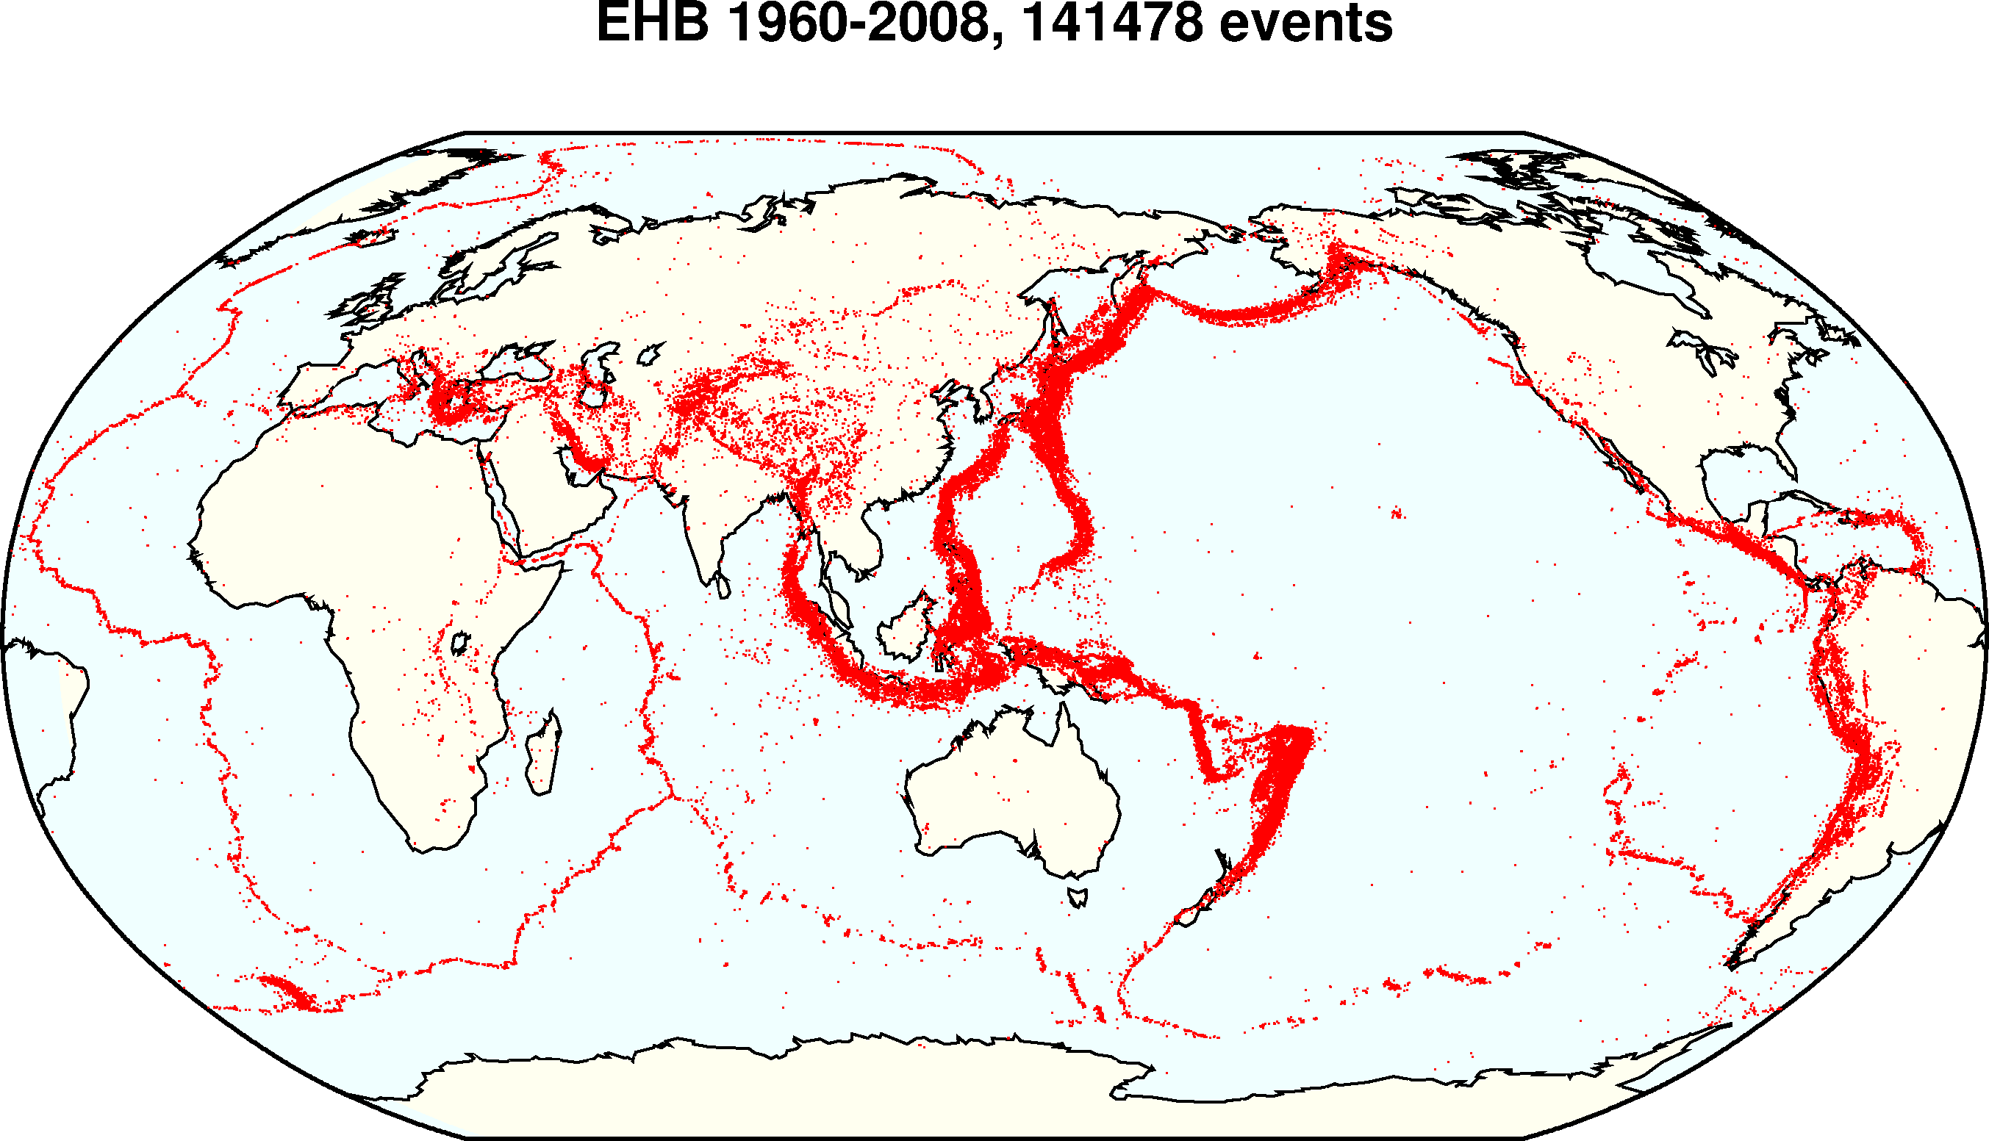
Global seismic monitoring for the Comprehensive Nuclear Test-Ban Treaty
IMS
Evidence: waveforms from 150 seismic stations
Query: what happened?
Model: geophysics of event occurrence, signal transmission, detection, noise
waveforms
bulletin
Notes:
Verification of the treaty requires continuous global seismic monitoring.
We do this using a probabilistic programming language, or PPL.
The *evidence* consists of seismic waveforms measured at 150 stations of the International Monitoring System (including several here in China).
The *query* is what happened today? The daily bulletin lists all seismic events.
The *model* is written in the PPL and captures what we know about the problem.

Slide 15
NET-VISA model
#SeismicEvents ~ Poisson[T*λ_{e}];
Time(e) ~ Uniform(0,T)
IsEarthQuake(e) ~ Bernoulli(.999);
Location(e) ~ if IsEarthQuake(e) then SpatialPrior() else UniformEarthDistribution();
Depth(e) ~ if IsEarthQuake(e) then Uniform[0,700] else 0;
Magnitude(e) ~ Exponential(log(10));
IsDetected(e,p,s) ~ Logistic[weights(s,p)](Magnitude(e), Depth(e), Distance(e,s));
#Detections(site = s) ~ Poisson[T*λ_{f}(s)];
#Detections(event=e, phase=p, station=s) = if IsDetected(e,p,s) then 1 else 0;
OnsetTime(a,s) ~ if (event(a) = null) then Uniform[0,T] else
Time(event(a)) + GeoTravelTime(Distance(event(a),s),Depth(event(a)),phase(a)) + Laplace(μ_{t}(s), σ_{t}(s))
Amplitude(a,s) ~ If (event(a) = null) then NoiseAmplitudeDistribution(s)
else AmplitudeModel(Magnitude(event(a)), Distance(event(a),s),Depth(event(a)),phase(a))
Azimuth(a,s) ~ If (event(a) = null) then Uniform(0, 360)
else GeoAzimuth(Location(event(a)),Depth(event(a)),phase(a),Site(s)) + Laplace(0,σ_{a}(s))
Slowness(a,s) ~ If (event(a) = null) then Uniform(0,20)
else GeoSlowness(Location(event(a)),Depth(event(a)),phase(a),Site(s)) + Laplace(0,σ_{a}(s))
ObservedPhase(a,s) ~ CategoricalPhaseModel(phase(a))
Notes:
Here it is, written in the BLOG language.
It’s entirely readable by a geophysicist, and took half an hour to write.
Then the quantitative aspects were trained from historical data.

Slide 16
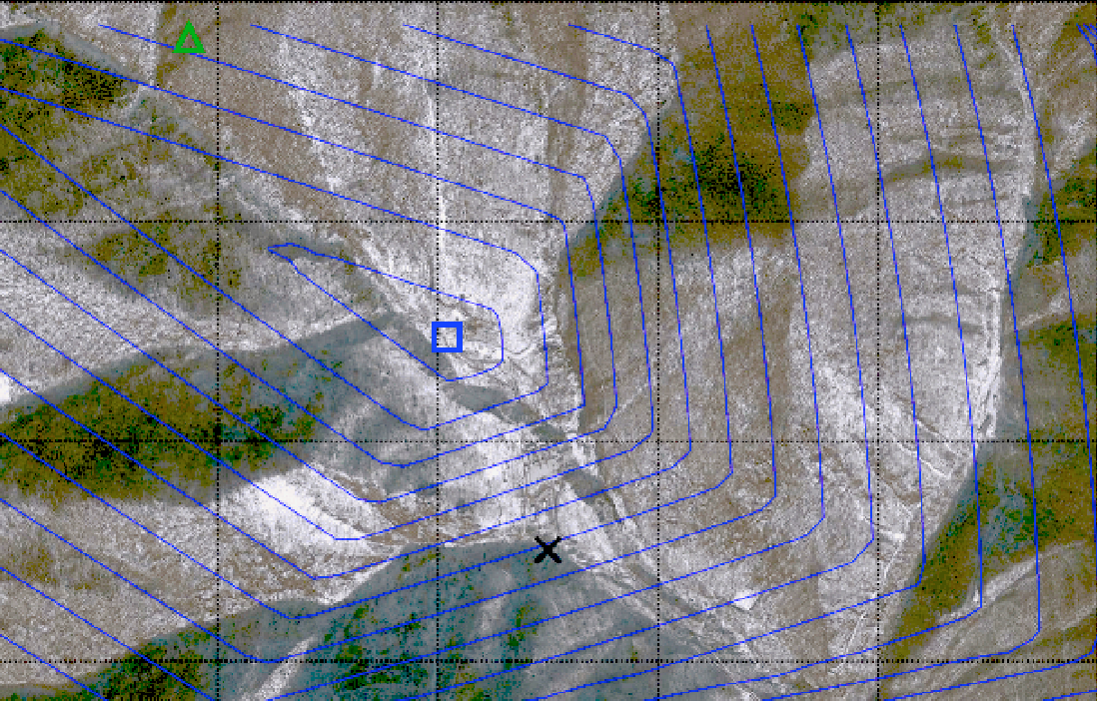
February 12, 2013 DPRK test
Global expert consensus location
NET-VISA location
Tunnel entrance
Notes:
For the 2012 nuclear test in North Korea, it gave a much more accurate location than
the consensus estimate from the world’s experts

Slide 17
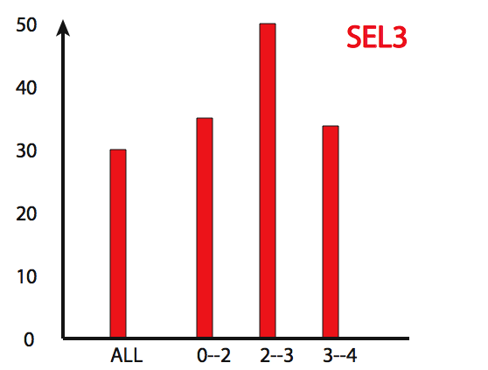
Fraction of events missed
Previous UN system
NET-VISA
As of January 1,
NETVISA is the operational system for the CTBT
magnitude
Magnitude
Notes:
Compared to the previous UN system, it is 2-3 times more sensitive from the same data.
As of January 1st, it is part of the deployed monitoring system for the treaty

Slide 18
Growth in PPL papers

Slide 19
Likely developments in the 2020s
Robots for war, roads, warehouses, mines, fields, home
Personal digital assistants for all aspects of life
Commercial language systems
Global vision system via satellite imagery
Notes:
So what can we expect to see in the world of applications?
With better perception and manipulation, we should see robots in everyday use outside the factory.
With even simple language understanding, search engines will *read* web pages rather than just indexing them,
so they can answer questions. And we’ll be applying image understanding to satellite data on a large scale

Slide 20
General-purpose AI
Still missing:
Real understanding of language
Integration of learning with knowledge
Long-range thinking at multiple levels of abstraction
Cumulative discovery of concepts and theories
Date unpredictable
Notes:
It’s important to understand we are not close to human-level AI; several breakthroughs are required

Slide 21
AI systems will eventually make better decisions than humans
(Alternative: we will fail in AI)
Turing’s point: how do we retain control over entities more powerful than us, for ever?
Russell, Many Experts Say We Shouldn't Worry About
Superintelligent AI. They're Wrong, IEEE Spectrum, October, 2019.
Notes:
Eventually – and I’m not going to say when! – AI systems will make better decisions than us in a wide range of tasks, which means taking into account more information, looking further into the future. Like AlphaGo, but in the real world not just the Go board.

Slide 22
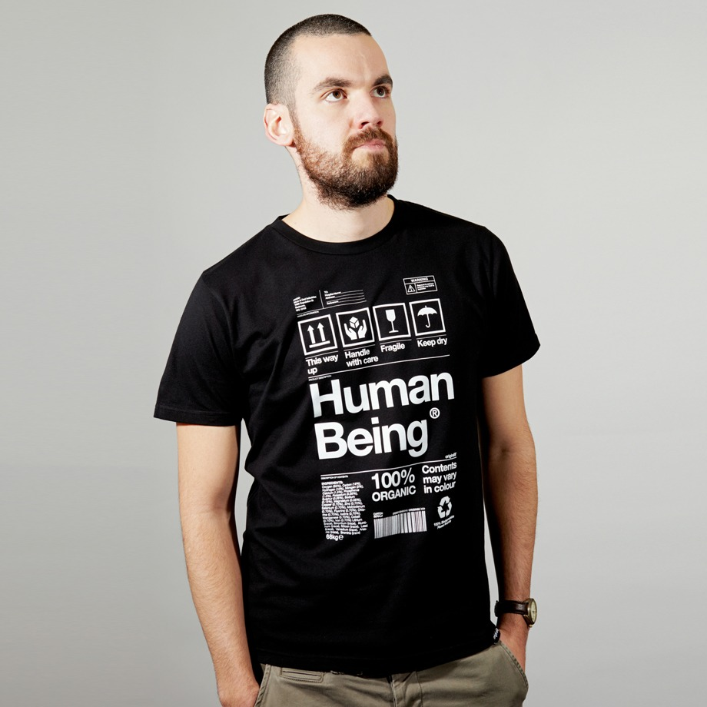
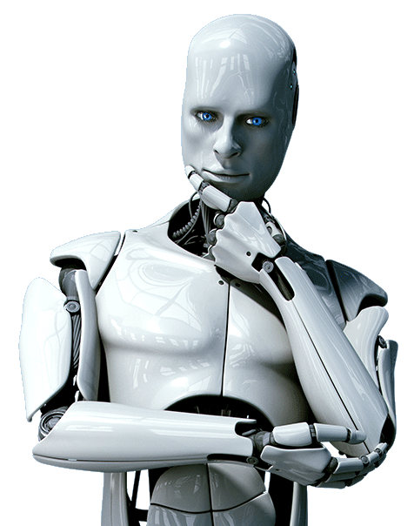
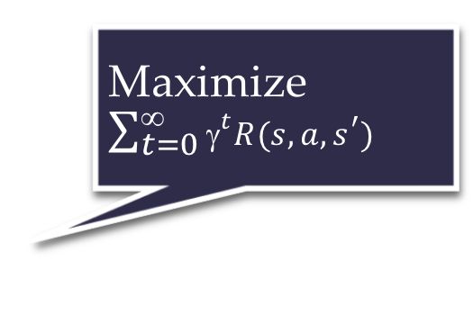
Standard model for AI
Maximize $\sum_{t=0}^{\text{∞}}{{\text{γ}}^{t}R(s,a,s^{′})}$
Righty-ho
Also the standard model for control theory,
statistics, operations research, economics.
The objective need not be explicitly represented in the agent.
The agent can be an entire distributed system.
King Midas problem: Cannot specify R correctly
Smarter AI => worse outcome

Slide 23
E.g., social media
Optimizing clickthrough
= learning what people want
= modifying people to be more predictable

Slide 24
How we got into this mess
Humans are intelligent to the extent that our actions can be expected to achieve our objectives
Machines are intelligent to the extent that their actions can be expected to achieve their objectives
Machines are beneficial to the extent that their actions can be expected to achieve our objectives

Slide 25
New model: Provably beneficial AI
1. Robot goal: satisfy human preferences*
2. Robot is uncertain about human preferences
3. Human behavior provides evidence* of preferences
=> assistance game with human and machine players
Smarter AI => better outcome

Slide 26
Basic assistance game
Preferences θ
Acts roughly according to θ
Maximize unknown human θ
Prior P(θ)
Equilibria:
Human teaches robot
Robot learns, asks questions, permission; defers to human; allows off-switch
[Hadfield-Menell et al, NeurIPS 16, IJCAI 17, NeurIPS 17]
[Milli et al 2017, IJCAI 17] [Malik et al, ICML 18]

Slide 27
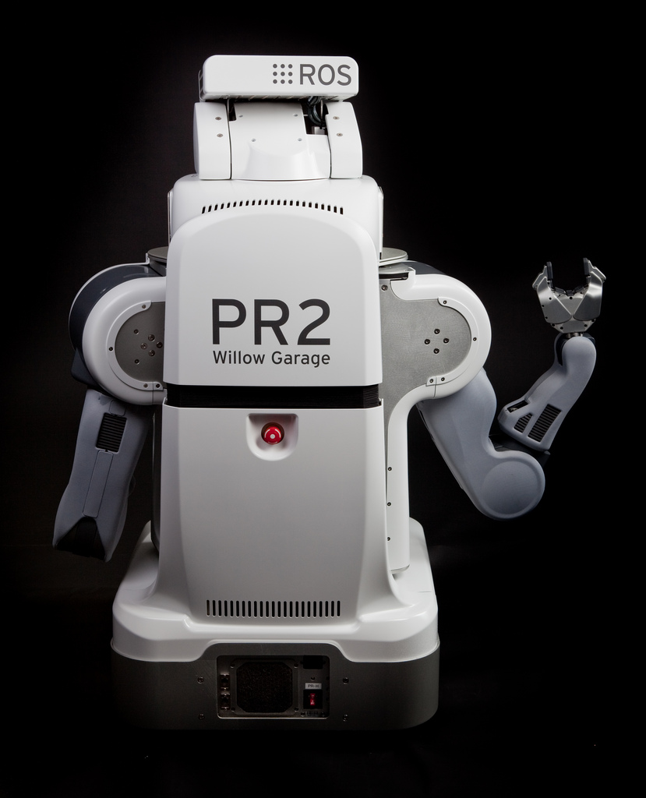
The off-switch problem
A robot, given an objective, has an incentive to disable its own off-switch
“You can’t fetch the coffee if you’re dead”
A robot with uncertainty about objective won’t behave this way

Slide 28
R
wait
U = U_{act}
H
U = 0
go ahead
R
U = 0
U = U_{act}
Theorem: robot has a positive incentive to allow itself to be switched off
Theorem: robot is provably beneficial

Slide 29
Rebuild AI on a New Foundation
Remove the assumption of a perfectly known objective/goal/loss/reward
Combinatorial search: G(s) and c(s,a,s’)
Constraint satisfaction: hard and soft constraints
Planning: G(s) and c(s,a,s’)
Markov decision processes: R(s,a,s’)
Supervised learning: Loss(x,y,y’)
Reinforcement learning: R(s,a,s’)
(Perception)
Robotics: all of the above

Slide 30
Ongoing research: “Imperfect” humans
Computationally limited
Hierarchically structured behavior
Emotionally driven behavior
Uncertainty about own preferences
Plasticity of preferences
Non-additive, memory-laden, retrospective/prospective preferences

Slide 31
Ongoing research: Many humans
Commonalities and differences in preferences
Aggregating individual preferences
Interpersonal comparisons of preferences
Potential humans (population ethics), future humans
Mechanism design for honesty-inducing assistance
Aggregation over individuals with different beliefs
Altruism/indifference/sadism; pride/rivalry/envy

Slide 32
One robot, many humans
How should a robot aggregate human preferences?
Harsanyi: Pareto-optimal policy optimizes a linear combination, assuming a common prior over the future
In general, Pareto-optimal policies have dynamic weights proportional to whose predictions turn out to be correct
Everyone prefers this policy because they think they are right
[Critch, Russell, Desai, NeurIPS 18]

Slide 33

Summary
The standard model for AI leads to loss of human control over increasingly intelligent AI systems
Provably beneficial AI is possible and desirable
It isn’t “AI safety” or “AI Ethics,” it’s AI
Problems of misuse
and overuse
are completely unsolved

Slide 34
Electronic calculators are superhuman at arithmetic. Calculators didn’t take over the world; therefore, there is no reason to worry about superhuman AI.
Horses have superhuman strength, and we don’t worry about proving that horses are safe; so we needn’t worry about proving that AI systems are safe.
Historically, there are zero examples of machines killing millions of humans, so, by induction, it cannot happen in the future.
No physical quantity in the universe can be infinite, and that includes intelligence, so concerns about superintelligence are overblown.
We don’t worry about species-ending but highly unlikely possibilities such as black holes materializing in near-Earth orbit, so why worry about superintelligent AI?

Slide 35
FB: You’d have to be extremely stupid to deploy a powerful system with the wrong objective
You mean, like clickthrough?
FB: We stopped using clickthrough as the sole objective a couple of years ago
Why did you stop?
FB: Because it was the wrong objective

Slide 36
Intelligence is multidimensional so “smarter than a human” is meaningless
=> “smarter than a chimpanzee” is meaningless
=> chimpanzees have nothing to fear from humans
QED

Slide 37
As machines become more intelligent they will automatically be benevolent and will behave in the best interests of humans
Antarctic krill
bacteria
aliens

